Slide 1
Trig Derivatives

Slide 2

The two main rules to remember are the following:
$\frac{d(\sin{x)}}{dx}=\cos{x}$ and $\frac{d(\cos{x)}}{dx}=−sin{x}$

Slide 3
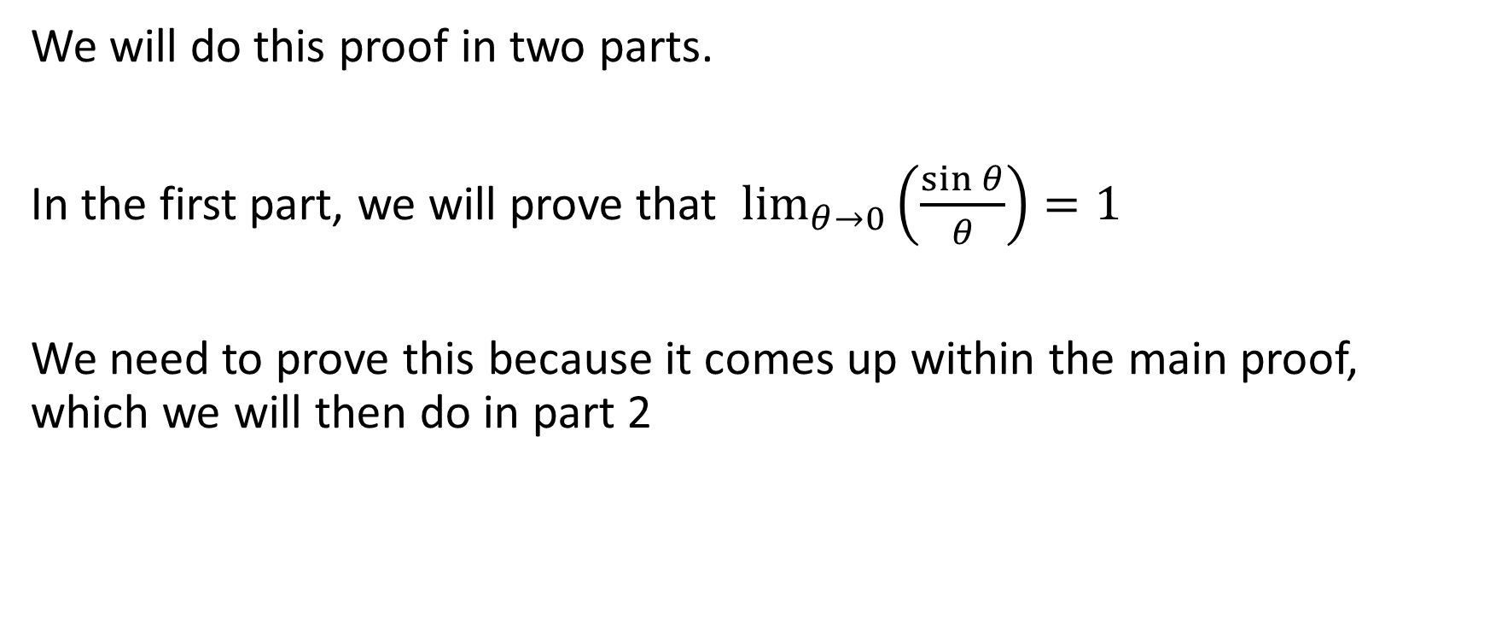

Proof that $\frac{d(\sin{θ)}}{dθ}=\cos{θ}$
We will do this proof in two parts.
In the first part, we will prove that $\lim_{θ→0}\left(\frac{\sin{θ}}{θ}\right)=1$
We need to prove this because it comes up within the main proof, which we will then do in part 2

Slide 4

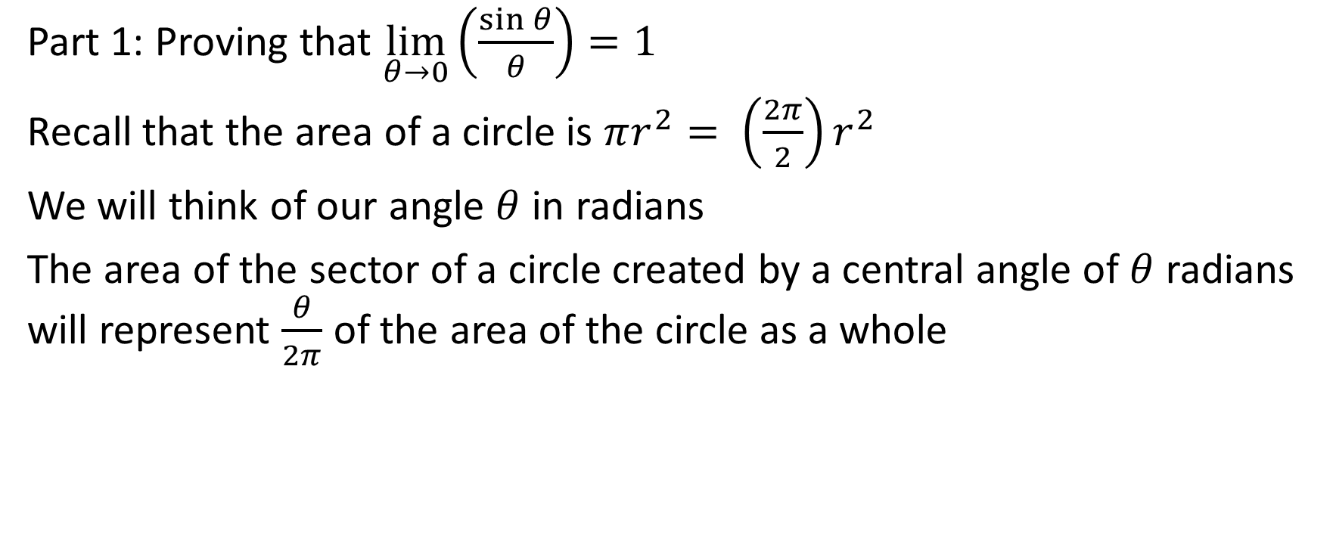



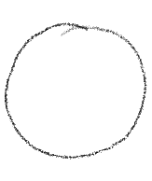


Part 1: Proving that $\lim_{θ→0}\left(\frac{\sin{θ}}{θ}\right)=1$
Part 1: Proving that $\lim_{θ→0}\left(\frac{\sin{θ}}{θ}\right)=1$
Recall that the area of a circle is $πr^{2}= \left(\frac{2π}{2}\right)r^{2}$
We will think of our angle $θ$ in radians
The area of the sector of a circle created by a central angle of $θ$ radians will represent $\frac{θ}{2π}$ of the area of the circle as a whole

Slide 5


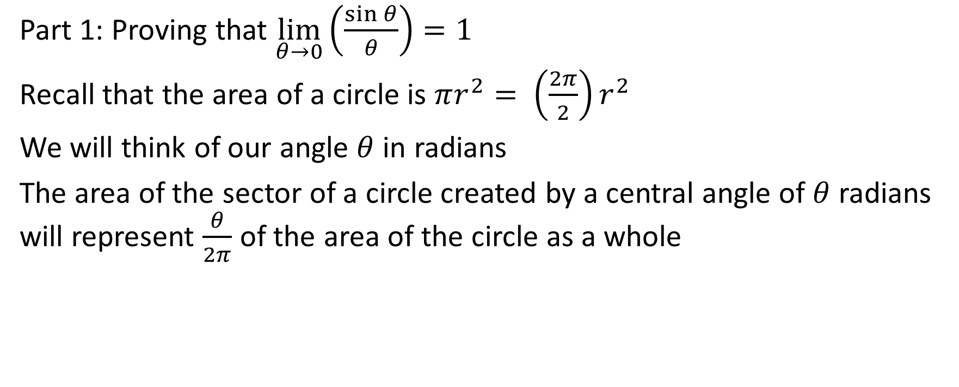

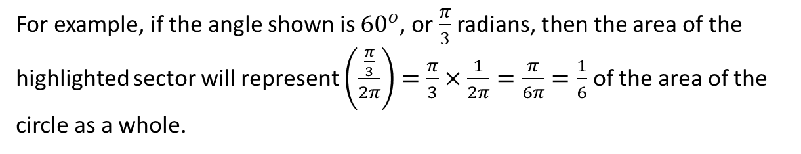

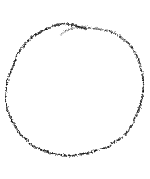

Part 1: Proving that $\lim_{θ→0}\left(\frac{\sin{θ}}{θ}\right)=1$
Recall that the area of a circle is $πr^{2}= \left(\frac{2π}{2}\right)r^{2}$
We will think of our angle $θ$ in radians
The area of the sector of a circle created by a central angle of $θ$ radians will represent $\frac{θ}{2π}$ of the area of the circle as a whole
For example, if the angle shown is ${60}^{o}$, or $\frac{π}{3}$ radians, then the area of the highlighted sector will represent $\left(\frac{\frac{π}{3}}{2π}\right)=\frac{π}{3}×\frac{1}{2π}=\frac{π}{6π}=\frac{1}{6}$ of the area of the circle as a whole.

Slide 6
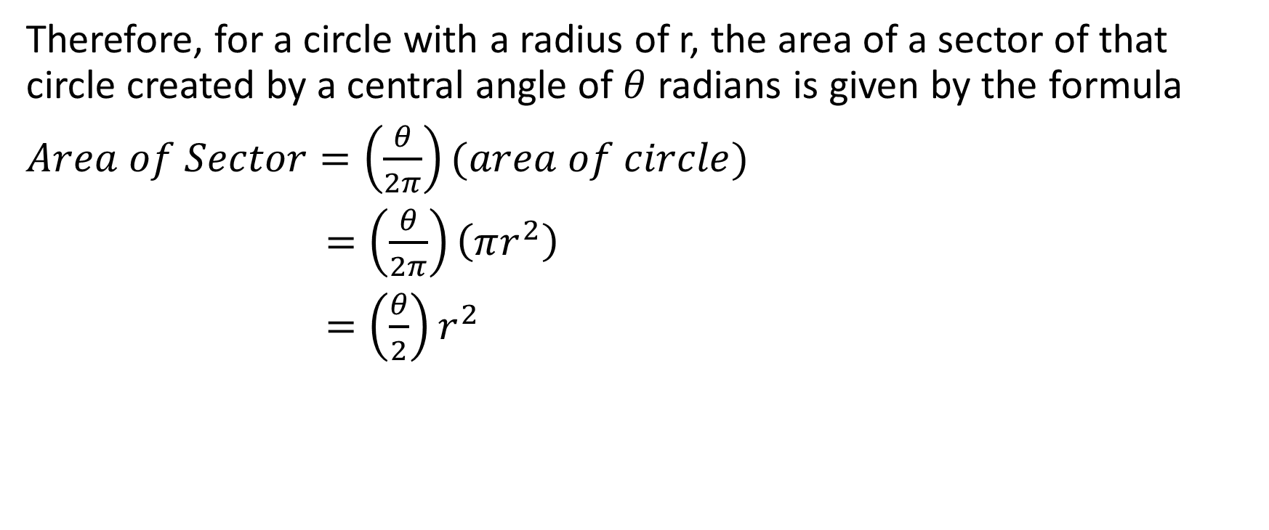
Therefore, for a circle with a radius of r, the area of a sector of that circle created by a central angle of $θ$ radians is given by the formula
$Area of Sector=\left(\frac{θ}{2π}\right)(area of circle)$
$=\left(\frac{θ}{2π}\right)\left(πr^{2}\right)$
$=\left(\frac{θ}{2}\right)r^{2}$

Slide 7
Therefore, for a circle with a radius of r, the area of a sector of that circle created by a central angle of $θ$ radians is given by the formula
$Area of Sector=\left(\frac{θ}{2π}\right)(area of circle)$
$=\left(\frac{θ}{2π}\right)\left(πr^{2}\right)$
$=\left(\frac{θ}{2}\right)r^{2}$
Now, let’s assume that we are talking about a circle with a radius of 1, and let’s redraw this circle.

Slide 8
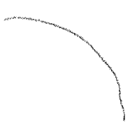

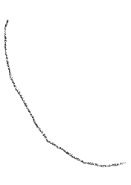


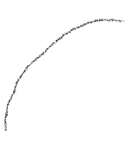
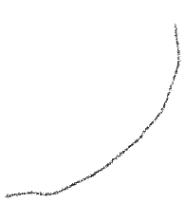



Slide 9
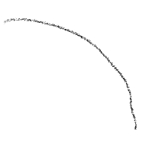


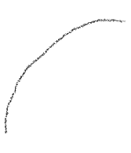
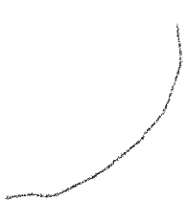



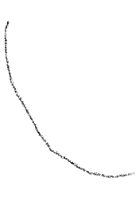



Slide 10






























Sector OAB

Slide 11


























Sector OAB
Triangle OCB

Slide 12
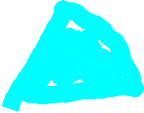


























Sector OAB
Triangle OCB
Sector OCD

Slide 13

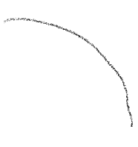


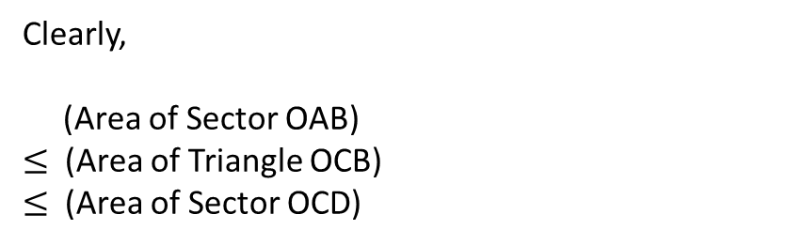
Sector OAB
Triangle OCB
Sector OCD
Clearly,
(Area of Sector OAB)
$≤$ (Area of Triangle OCB)
$≤$ (Area of Sector OCD)

Slide 14
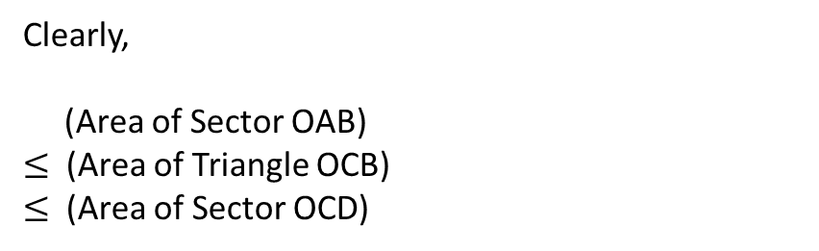
Clearly,
(Area of Sector OAB)
$≤$ (Area of Triangle OCB)
$≤$ (Area of Sector OCD)

Slide 15


Clearly,
(Area of Sector OAB)
$≤$ (Area of Triangle OCB)
$≤$ (Area of Sector OCD)

Slide 16


Clearly,
(Area of Sector OAB)
$≤$ (Area of Triangle OCB)
$≤$ (Area of Sector OCD)

Slide 17


Clearly,
(Area of Sector OAB)
$≤$ (Area of Triangle OCB)
$≤$ (Area of Sector OCD)

Slide 18

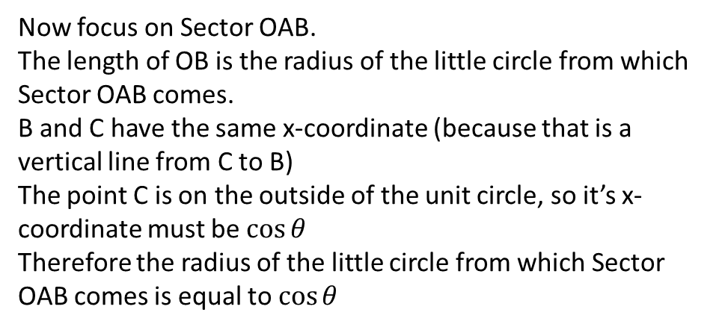
Clearly,
(Area of Sector OAB)
$≤$ (Area of Triangle OCB)
$≤$ (Area of Sector OCD)
Now focus on Sector OAB.
The length of OB is the radius of the little circle from which Sector OAB comes.
B and C have the same x-coordinate (because that is a vertical line from C to B)
The point C is on the outside of the unit circle, so it’s x-coordinate must be $\cos{θ}$
Therefore the radius of the little circle from which Sector OAB comes is equal to $\cos{θ}$

Slide 19




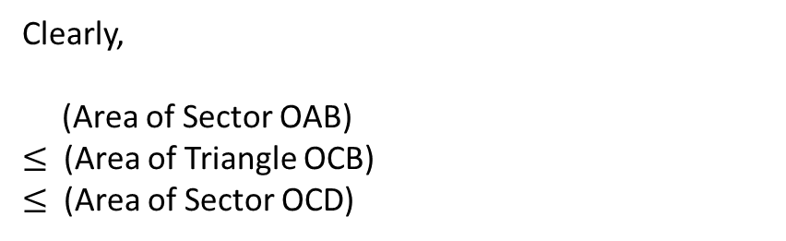
Clearly,
(Area of Sector OAB)
$≤$ (Area of Triangle OCB)
$≤$ (Area of Sector OCD)
Now focus on Sector OAB.
The length of OB is the radius of the little circle from which Sector OAB comes.
B and C have the same x-coordinate (because that is a vertical line from C to B)
The point C is on the outside of the unit circle, so it’s x-coordinate must be $\cos{θ}$
Therefore the radius of the little circle from which Sector OAB comes is equal to $\cos{θ}$

Slide 20
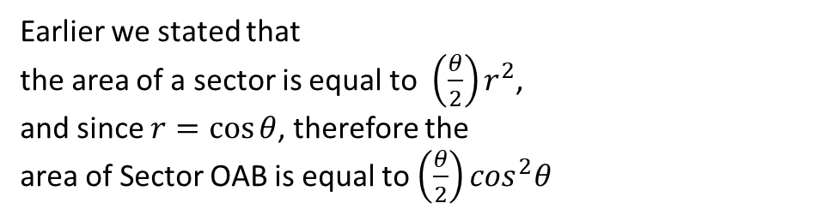



Clearly,
(Area of Sector OAB)
$≤$ (Area of Triangle OCB)
$≤$ (Area of Sector OCD)
Earlier we stated that
the area of a sector is equal to $\left(\frac{θ}{2}\right)r^{2}$,
and since $r=\cos{θ}$, therefore the
area of Sector OAB is equal to $\left(\frac{θ}{2}\right)\cos^{2}θ$

Slide 21

Clearly,
(Area of Sector OAB)
$≤$ (Area of Triangle OCB)
$≤$ (Area of Sector OCD)
area of Sector OAB is equal to $\left(\frac{θ}{2}\right)\cos^{2}θ$

Slide 22
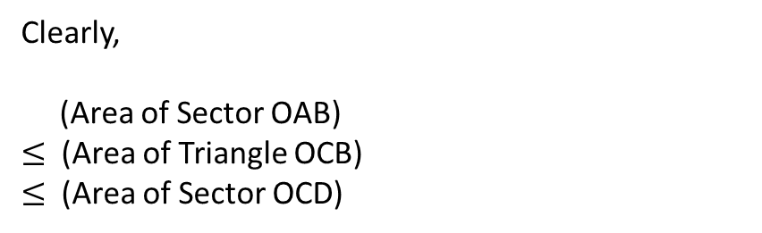


Clearly,
(Area of Sector OAB)
$≤$ (Area of Triangle OCB)
$≤$ (Area of Sector OCD)
Now, let’s focus on Triangle OCB
area of Sector OAB is equal to $\left(\frac{θ}{2}\right)\cos^{2}θ$

Slide 23



Clearly,
(Area of Sector OAB)
$≤$ (Area of Triangle OCB)
$≤$ (Area of Sector OCD)
Now, let’s focus on Triangle OCB
We know that the area of the triangle is $\frac{1}{2}bh$. We see that the base of that triangle is $\cos{θ}$.
The height of the triangle is equal to the y coordinate of C. Since C is a point on the outside of a unit circle, therefore the y coordinate of point C is $\sin{θ}$
Therefore, the height of the triangle is equal to $\sin{θ}$.
Therefore, the area of Triangle OCB is $\frac{1}{2}\cos{θ\sin{θ}}$
area of Sector OAB is equal to $\left(\frac{θ}{2}\right)\cos^{2}θ$

Slide 24
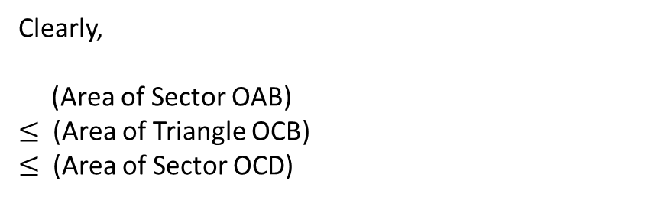

Clearly,
(Area of Sector OAB)
$≤$ (Area of Triangle OCB)
$≤$ (Area of Sector OCD)
area of Sector OAB is equal to $\left(\frac{θ}{2}\right)\cos^{2}θ$
area of Triangle OCB is $\frac{1}{2}\cos{θ\sin{θ}}$

Slide 25
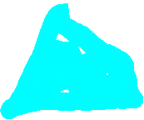

Clearly,
(Area of Sector OAB)
$≤$ (Area of Triangle OCB)
$≤$ (Area of Sector OCD)
Now, let’s focus on Sector OCD.
As we’ve stated, we know that the area of a sector is$\left(\frac{θ}{2}\right)r^{2}$. Since the radius of that sector is 1 (because it is a sector from a unit circle), therefore the area of Sector OCD is $\left(\frac{θ}{2}\right){\left(1\right)}^{2}$.
In other words, the area of Sector OCD is $\frac{θ}{2}$
area of Sector OAB is equal to $\left(\frac{θ}{2}\right)\cos^{2}θ$
area of Triangle OCB is $\frac{1}{2}\cos{θ\sin{θ}}$

Slide 26


Clearly,
(Area of Sector OAB)
$≤$ (Area of Triangle OCB)
$≤$ (Area of Sector OCD)
area of Sector OAB is equal to $\left(\frac{θ}{2}\right)\cos^{2}θ$
area of Triangle OCB is $\frac{1}{2}\cos{θ\sin{θ}}$
area of Sector OCD is $\frac{θ}{2}$

Slide 27

Clearly,
(Area of Sector OAB)
$≤$ (Area of Triangle OCB)
$≤$ (Area of Sector OCD)
Putting together the statement above and the statement to the right, we get
$\left(\frac{θ}{2}\right)\cos^{2}θ≤\frac{1}{2}\cos{θ\sin{θ≤\frac{θ}{2}}}$
area of Sector OAB is equal to $\left(\frac{θ}{2}\right)\cos^{2}θ$
area of Triangle OCB is $\frac{1}{2}\cos{θ\sin{θ}}$
area of Sector OCD is $\frac{θ}{2}$

Slide 28
$\left(\frac{θ}{2}\right)\cos^{2}θ≤\frac{1}{2}\cos{θ\sin{θ≤\frac{θ}{2}}}$
area of Sector OAB is equal to $\left(\frac{θ}{2}\right)\cos^{2}θ$
area of Triangle OCB is $\frac{1}{2}\cos{θ\sin{θ}}$
area of Sector OCD is $\frac{θ}{2}$

Slide 29

$\left(\frac{θ}{2}\right)\cos^{2}θ≤\frac{1}{2}\cos{θ\sin{θ≤\frac{θ}{2}}}$
Multiplying the left middle and right by $\frac{2}{θ\cos{θ}}$ gives us
$$\left(\frac{θ}{2}\right)\cos^{2}θ\left[\frac{2}{θ\cos{θ}}\right]≤\frac{1}{2}\cos{θ\sin{θ\left[\frac{2}{θ\cos{θ}}\right] ≤\left(\frac{θ}{2}\right)\left[\frac{2}{θ\cos{θ}}\right]}}$$
area of Sector OAB is equal to $\left(\frac{θ}{2}\right)\cos^{2}θ$
area of Triangle OCB is $\frac{1}{2}\cos{θ\sin{θ}}$
area of Sector OCD is $\frac{θ}{2}$

Slide 30

$\left(\frac{θ}{2}\right)\cos^{2}θ≤\frac{1}{2}\cos{θ\sin{θ≤\frac{θ}{2}}}$
Multiplying the left middle and right by $\frac{2}{θ\cos{θ}}$ gives us
$$\left(\frac{θ}{2}\right)\cos^{2}θ\left[\frac{2}{θ\cos{θ}}\right]≤\frac{1}{2}\cos{θ\sin{θ\left[\frac{2}{θ\cos{θ}}\right] ≤\left(\frac{θ}{2}\right)\left[\frac{2}{θ\cos{θ}}\right]}}$$
area of Sector OAB is equal to $\left(\frac{θ}{2}\right)\cos^{2}θ$
area of Triangle OCB is $\frac{1}{2}\cos{θ\sin{θ}}$
area of Sector OCD is $\frac{θ}{2}$

Slide 31


$\left(\frac{θ}{2}\right)\cos^{2}θ≤\frac{1}{2}\cos{θ\sin{θ≤\frac{θ}{2}}}$
Multiplying the left middle and right by $\frac{2}{θ\cos{θ}}$ gives us
$$\left(\frac{θ}{2}\right)\cos^{2}θ\left[\frac{2}{θ\cos{θ}}\right]≤\frac{1}{2}\cos{θ\sin{θ\left[\frac{2}{θ\cos{θ}}\right] ≤\left(\frac{θ}{2}\right)\left[\frac{2}{θ\cos{θ}}\right]}}$$
$\cos{θ≤\frac{\sin{θ}}{θ}}≤\frac{1}{\cos{θ}}$
area of Sector OAB is equal to $\left(\frac{θ}{2}\right)\cos^{2}θ$
area of Triangle OCB is $\frac{1}{2}\cos{θ\sin{θ}}$
area of Sector OCD is $\frac{θ}{2}$

Slide 32
$\cos{θ≤\frac{\sin{θ}}{θ}}≤\frac{1}{\cos{θ}}$
area of Sector OAB is equal to $\left(\frac{θ}{2}\right)\cos^{2}θ$
area of Triangle OCB is $\frac{1}{2}\cos{θ\sin{θ}}$
area of Sector OCD is $\frac{θ}{2}$

Slide 33

$\cos{θ≤\frac{\sin{θ}}{θ}}≤\frac{1}{\cos{θ}}$
Determine the limit as $θ→0$ of the left, middle and right
$\lim_{θ→0}{\cos{θ≤\lim_{θ→0}{\frac{\sin{θ}}{θ}}≤\lim_{θ→0}{\frac{1}{\cos{θ}}}}}$
We can evaluate the left and the right be simply subbing in a value of $θ=0$ because those functions are continuous in the neighbourhood around $θ=0$
$\cos{0≤\lim_{θ→0}{\frac{\sin{θ}}{θ}}≤\frac{1}{\cos{0}}}$
$1≤\lim_{θ→0}{\frac{\sin{θ}}{θ}≤\frac{1}{1}}$
$1≤\lim_{θ→0}{\frac{\sin{θ}}{θ}≤1}$
area of Sector OAB is equal to $\left(\frac{θ}{2}\right)\cos^{2}θ$
area of Triangle OCB is $\frac{1}{2}\cos{θ\sin{θ}}$
area of Sector OCD is $\frac{θ}{2}$

Slide 34

$1≤\lim_{θ→0}{\frac{\sin{θ}}{θ}≤1}$
area of Sector OAB is equal to $\left(\frac{θ}{2}\right)\cos^{2}θ$
area of Triangle OCB is $\frac{1}{2}\cos{θ\sin{θ}}$
area of Sector OCD is $\frac{θ}{2}$

Slide 35


$1≤\lim_{θ→0}{\frac{\sin{θ}}{θ}≤1}$
This next part is really cool.
The only way that 1 can be both less than or equal to a particular quantity and that the same quantity is less than or equal to 1 is if that quantity is equal to 1.
In other words, that quantity is being squeezed so that it’s only possible value is 1
Therefore, $\lim_{θ→0}{\frac{\sin{θ}}{θ}=1}$
area of Sector OAB is equal to $\left(\frac{θ}{2}\right)\cos^{2}θ$
area of Triangle OCB is $\frac{1}{2}\cos{θ\sin{θ}}$
area of Sector OCD is $\frac{θ}{2}$

Slide 36

Part 2: We needed that result because there will be a moment in our proof that $\frac{d(\sin{θ)}}{dθ}=\cos{θ}$ where that value comes up.
Notes:
n

Slide 37
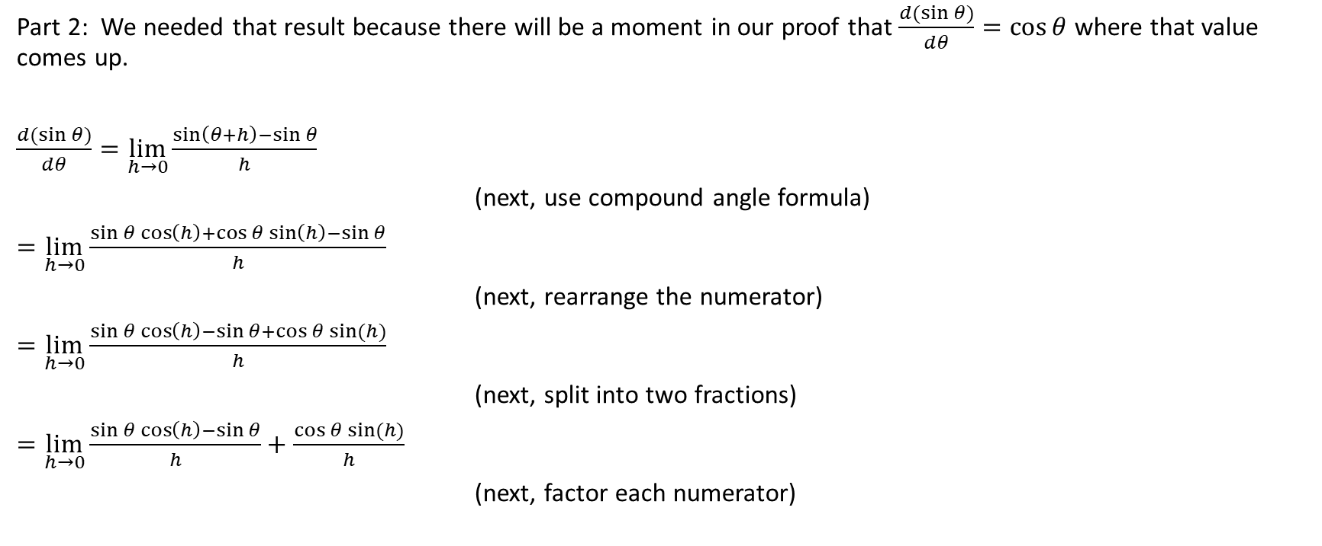
Part 2: We needed that result because there will be a moment in our proof that $\frac{d(\sin{θ)}}{dθ}=\cos{θ}$ where that value comes up.
$\frac{d(\sin{θ)}}{dθ}=\lim_{h→0}{\frac{\sin\left(θ+h\right)−\sin{θ}}{h}}$
(next, use compound angle formula)
$=\lim_{h→0}{\frac{\sin{θ\cos\left(h\right)+\cos{θ\sin\left(h\right)−\sin{θ}}}}{h}}$
(next, rearrange the numerator)
$=\lim_{h→0}{\frac{\sin{θ\cos\left(h\right)−\sin{θ}+\cos{θ\sin{(h)}}}}{h}}$
(next, split into two fractions)
$=\lim_{h→0}{\frac{\sin{θ\cos\left(h\right)−\sin{θ}}}{h}+\frac{\cos{θ\sin{(h)}}}{h}}$
(next, factor each numerator)
Notes:
n

Slide 38

$=\lim_{h→0}{\frac{\sin{θ\cos\left(h\right)−\sin{θ}}}{h}+\frac{\cos{θ\sin{(h)}}}{h}}$
(next, factor each numerator)
Notes:
n

Slide 39
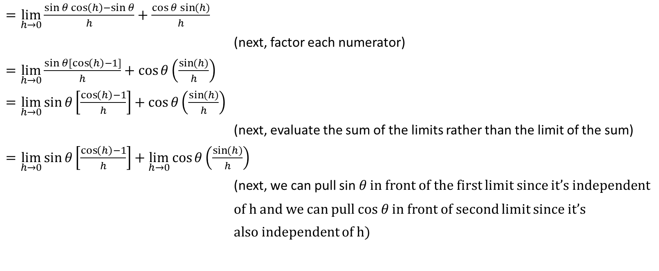
$=\lim_{h→0}{\frac{\sin{θ\cos\left(h\right)−\sin{θ}}}{h}+\frac{\cos{θ\sin{(h)}}}{h}}$
(next, factor each numerator)
$=\lim_{h→0}{\frac{\sin{θ[\cos\left(h\right)−1]}}{h}+\cos{θ\left(\frac{\sin{(h)}}{h}\right)}}$
$=\lim_{h→0}{\sin{θ\left[\frac{\cos\left(h\right)−1}{h}\right]+\cos{θ\left(\frac{\sin{(h)}}{h}\right)}}}$
(next, evaluate the sum of the limits rather than the limit of the sum)
$=\lim_{h→0}{\sin{θ\left[\frac{\cos\left(h\right)−1}{h}\right]+\lim_{h→0}{\cos{θ\left(\frac{\sin{(h)}}{h}\right)}}}}$
(next, we can pull sin 𝜃 in front of the first limit since it’s independent
of h and we can pull cos 𝜃 in front of second limit since it’s
also independent of h)
Notes:
n

Slide 40

$=\lim_{h→0}{\sin{θ\left[\frac{\cos\left(h\right)−1}{h}\right]+\lim_{h→0}{\cos{θ\left(\frac{\sin{(h)}}{h}\right)}}}}$
(next, we can pull sin 𝜃 in front of the first limit since it’s independent
of h and we can pull cos 𝜃 in front of second limit since it’s
also independent of h)
Notes:
n

Slide 41

$=\lim_{h→0}{\sin{θ\left[\frac{\cos\left(h\right)−1}{h}\right]+\lim_{h→0}{\cos{θ\left(\frac{\sin{(h)}}{h}\right)}}}}$
(next, we can pull sin 𝜃 in front of the first limit since it’s independent
of h and we can pull cos 𝜃 in front of second limit since it’s
also independent of h
$=\sin{θ\lim_{h→0}{\frac{\cos\left(h\right)−1}{h}+\cos{θ\lim_{h→0}{\frac{sin⁡(h)}{h}}}}}$
Notes:
n

Slide 42

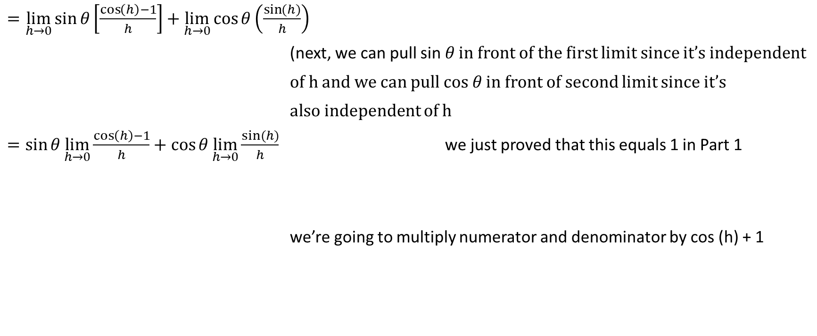
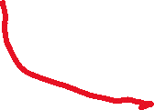

$=\lim_{h→0}{\sin{θ\left[\frac{\cos\left(h\right)−1}{h}\right]+\lim_{h→0}{\cos{θ\left(\frac{\sin{(h)}}{h}\right)}}}}$
(next, we can pull sin 𝜃 in front of the first limit since it’s independent
of h and we can pull cos 𝜃 in front of second limit since it’s
also independent of h
$=\sin{θ\lim_{h→0}{\frac{\cos\left(h\right)−1}{h}+\cos{θ\lim_{h→0}{\frac{sin⁡(h)}{h}}}}}$ we just proved that this equals 1 in Part 1
we’re going to multiply numerator and denominator by cos (h) + 1
Notes:
n

Slide 43
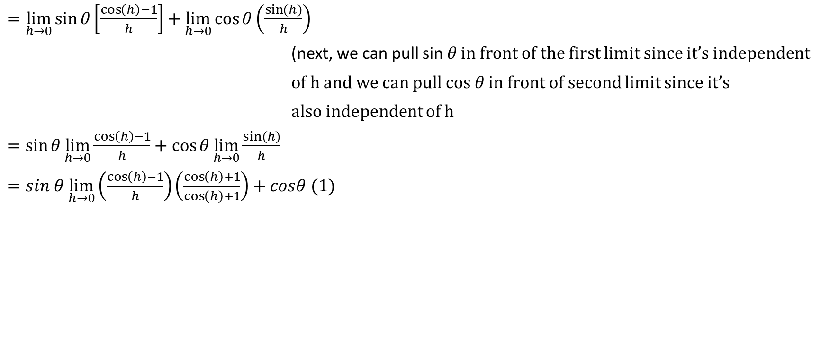
$=\lim_{h→0}{\sin{θ\left[\frac{\cos\left(h\right)−1}{h}\right]+\lim_{h→0}{\cos{θ\left(\frac{\sin{(h)}}{h}\right)}}}}$
(next, we can pull sin 𝜃 in front of the first limit since it’s independent
of h and we can pull cos 𝜃 in front of second limit since it’s
also independent of h
$=\sin{θ\lim_{h→0}{\frac{\cos\left(h\right)−1}{h}+\cos{θ\lim_{h→0}{\frac{sin⁡(h)}{h}}}}}$
$=sin θ \lim_{h→0}\left(\frac{\cos\left(h\right)−1}{h}\right)\left(\frac{\cos\left(h\right)+1}{\cos\left(h\right)+1}\right)+cosθ (1)$
Notes:
n

Slide 44
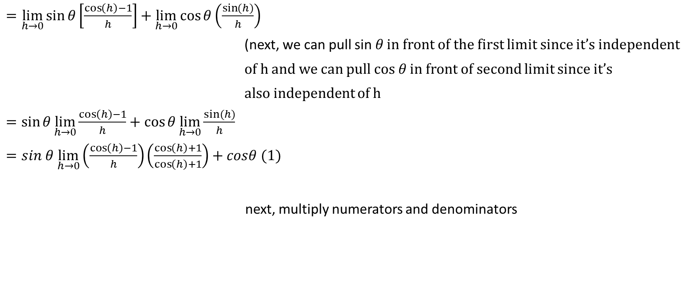


$=\lim_{h→0}{\sin{θ\left[\frac{\cos\left(h\right)−1}{h}\right]+\lim_{h→0}{\cos{θ\left(\frac{\sin{(h)}}{h}\right)}}}}$
(next, we can pull sin 𝜃 in front of the first limit since it’s independent
of h and we can pull cos 𝜃 in front of second limit since it’s
also independent of h
$=\sin{θ\lim_{h→0}{\frac{\cos\left(h\right)−1}{h}+\cos{θ\lim_{h→0}{\frac{sin⁡(h)}{h}}}}}$
$=sin θ \lim_{h→0}\left(\frac{\cos\left(h\right)−1}{h}\right)\left(\frac{\cos\left(h\right)+1}{\cos\left(h\right)+1}\right)+cosθ (1)$
next, multiply numerators and denominators
Notes:
n

Slide 45
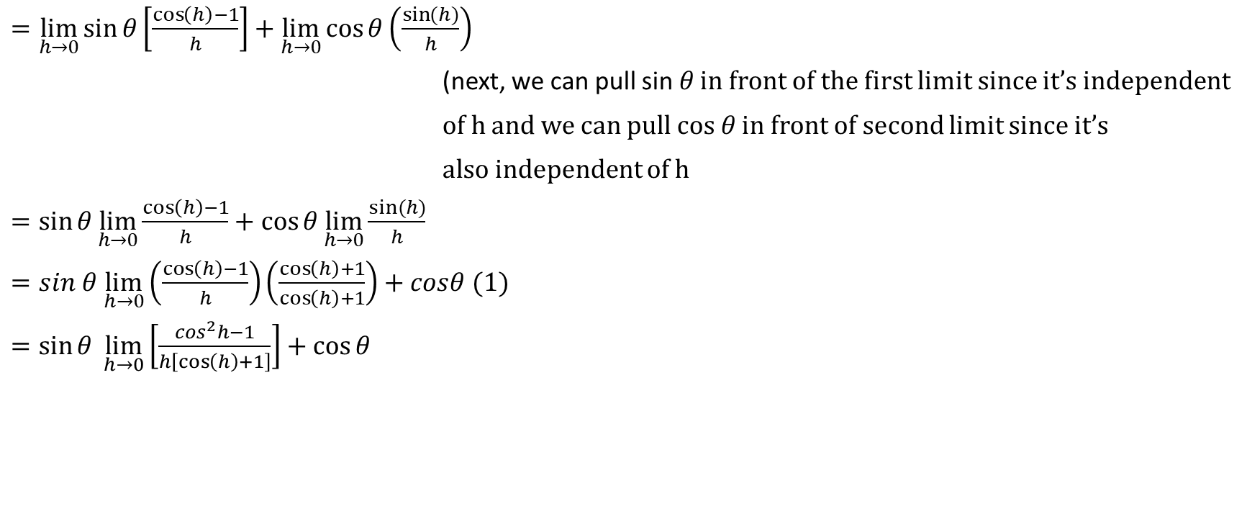
$=\lim_{h→0}{\sin{θ\left[\frac{\cos\left(h\right)−1}{h}\right]+\lim_{h→0}{\cos{θ\left(\frac{\sin{(h)}}{h}\right)}}}}$
(next, we can pull sin 𝜃 in front of the first limit since it’s independent
of h and we can pull cos 𝜃 in front of second limit since it’s
also independent of h
$=\sin{θ\lim_{h→0}{\frac{\cos\left(h\right)−1}{h}+\cos{θ\lim_{h→0}{\frac{sin⁡(h)}{h}}}}}$
$=sin θ \lim_{h→0}\left(\frac{\cos\left(h\right)−1}{h}\right)\left(\frac{\cos\left(h\right)+1}{\cos\left(h\right)+1}\right)+cosθ (1)$
$=\sin{θ \lim_{h→0}\left[\frac{\cos^{2}h−1}{h\left[\cos\left(h\right)+1\right]}\right]+\cos{θ}}$
Notes:
n

Slide 46
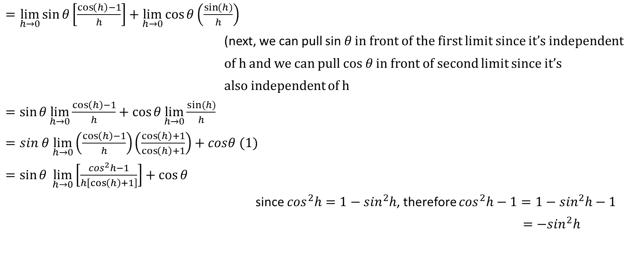


$=\lim_{h→0}{\sin{θ\left[\frac{\cos\left(h\right)−1}{h}\right]+\lim_{h→0}{\cos{θ\left(\frac{\sin{(h)}}{h}\right)}}}}$
(next, we can pull sin 𝜃 in front of the first limit since it’s independent
of h and we can pull cos 𝜃 in front of second limit since it’s
also independent of h
$=\sin{θ\lim_{h→0}{\frac{\cos\left(h\right)−1}{h}+\cos{θ\lim_{h→0}{\frac{sin⁡(h)}{h}}}}}$
$=sin θ \lim_{h→0}\left(\frac{\cos\left(h\right)−1}{h}\right)\left(\frac{\cos\left(h\right)+1}{\cos\left(h\right)+1}\right)+cosθ (1)$
$=\sin{θ \lim_{h→0}\left[\frac{\cos^{2}h−1}{h\left[\cos\left(h\right)+1\right]}\right]+\cos{θ}}$
since $\cos^{2}h=1−\sin^{2}h$, therefore $\cos^{2}h−1=1−\sin^{2}h−1$
$=−\sin^{2}h$
Notes:
n

Slide 47
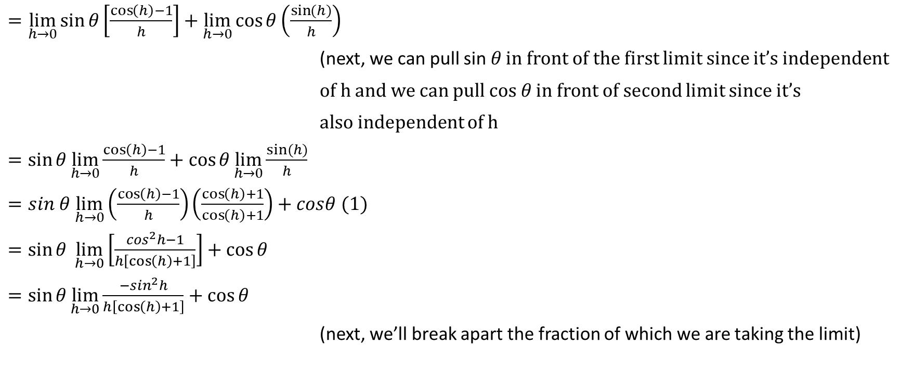
$=\lim_{h→0}{\sin{θ\left[\frac{\cos\left(h\right)−1}{h}\right]+\lim_{h→0}{\cos{θ\left(\frac{\sin{(h)}}{h}\right)}}}}$
(next, we can pull sin 𝜃 in front of the first limit since it’s independent
of h and we can pull cos 𝜃 in front of second limit since it’s
also independent of h
$=\sin{θ\lim_{h→0}{\frac{\cos\left(h\right)−1}{h}+\cos{θ\lim_{h→0}{\frac{sin⁡(h)}{h}}}}}$
$=sin θ \lim_{h→0}\left(\frac{\cos\left(h\right)−1}{h}\right)\left(\frac{\cos\left(h\right)+1}{\cos\left(h\right)+1}\right)+cosθ (1)$
$=\sin{θ \lim_{h→0}\left[\frac{\cos^{2}h−1}{h\left[\cos\left(h\right)+1\right]}\right]+\cos{θ}}$
$=\sin{θ\lim_{h→0}{\frac{−\sin^{2}h}{h\left[\cos\left(h\right)+1\right]}+\cos{θ}}}$
(next, we’ll break apart the fraction of which we are taking the limit)
Notes:
n

Slide 48

$=\sin{θ\lim_{h→0}{\frac{−\sin^{2}h}{h\left[\cos\left(h\right)+1\right]}+\cos{θ}}}$
(next, we’ll break apart the fraction of which we are taking the limit)
Notes:
n

Slide 49
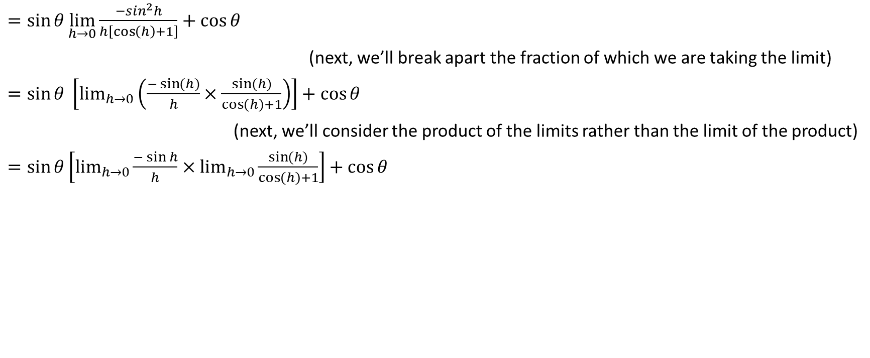
$=\sin{θ\lim_{h→0}{\frac{−\sin^{2}h}{h\left[\cos\left(h\right)+1\right]}+\cos{θ}}}$
(next, we’ll break apart the fraction of which we are taking the limit)
$=\sin{θ \left[\lim_{h→0}\left(\frac{−\sin{(h)}}{h}×\frac{\sin{(h)}}{\cos\left(h\right)+1}\right)\right]+\cos{θ}}$
(next, we’ll consider the product of the limits rather than the limit of the product)
$=\sin{θ\left[\lim_{h→0}{\frac{−\sin{h}}{h}×\lim_{h→0}{\frac{\sin{(h)}}{\cos\left(h\right)+1}}}\right]+\cos{θ}}$
Notes:
n

Slide 50
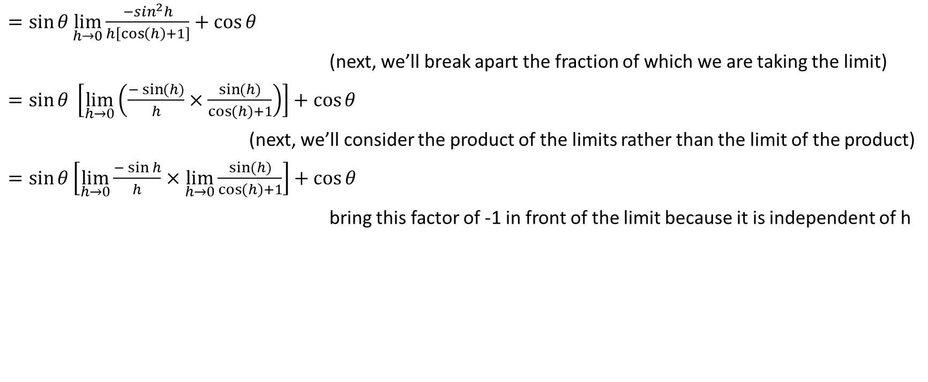


$=\sin{θ\lim_{h→0}{\frac{−\sin^{2}h}{h\left[\cos\left(h\right)+1\right]}+\cos{θ}}}$
(next, we’ll break apart the fraction of which we are taking the limit)
$=\sin{θ \left[\lim_{h→0}\left(\frac{−\sin{(h)}}{h}×\frac{\sin{(h)}}{\cos\left(h\right)+1}\right)\right]+\cos{θ}}$
(next, we’ll consider the product of the limits rather than the limit of the product)
$=\sin{θ\left[\lim_{h→0}{\frac{−\sin{h}}{h}×\lim_{h→0}{\frac{\sin{(h)}}{\cos\left(h\right)+1}}}\right]+\cos{θ}}$
bring this factor of -1 in front of the limit because it is independent of h
Notes:
n

Slide 51
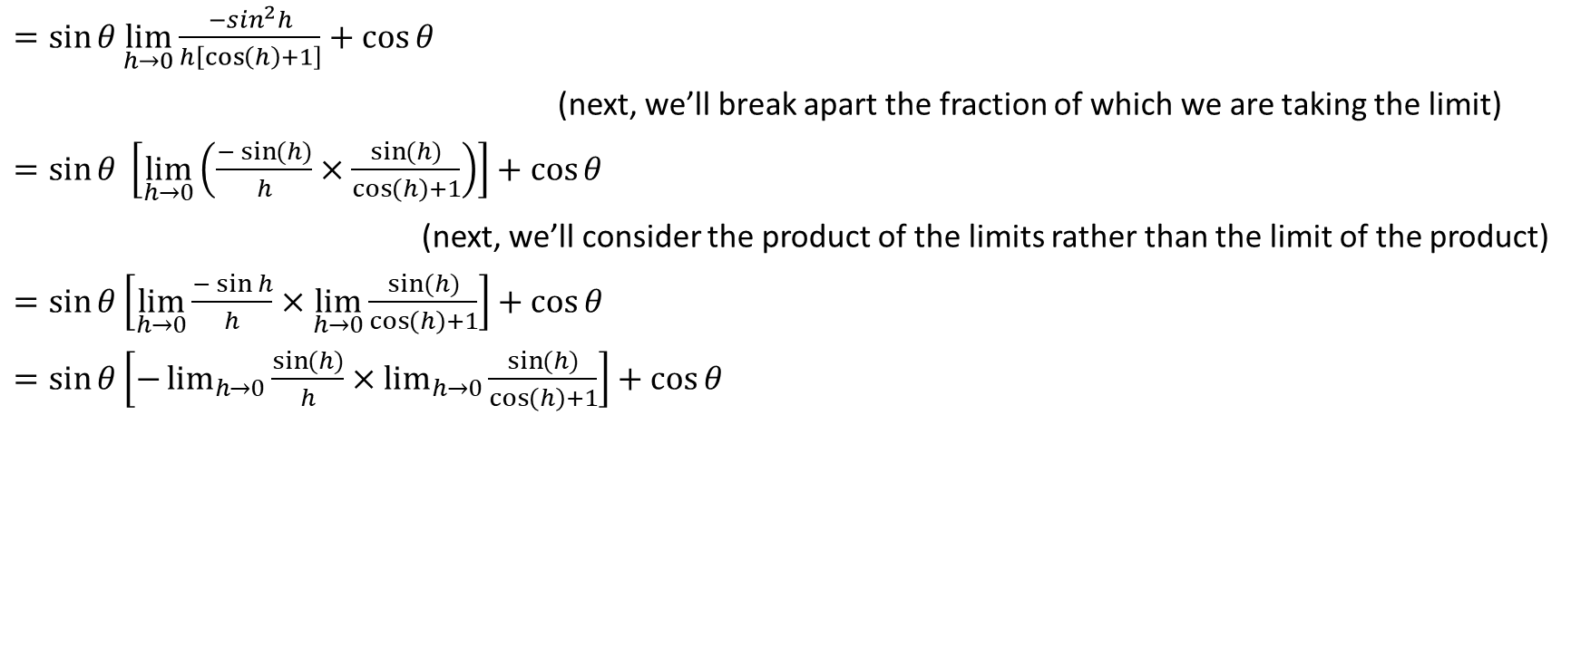
$=\sin{θ\lim_{h→0}{\frac{−\sin^{2}h}{h\left[\cos\left(h\right)+1\right]}+\cos{θ}}}$
(next, we’ll break apart the fraction of which we are taking the limit)
$=\sin{θ \left[\lim_{h→0}\left(\frac{−\sin{(h)}}{h}×\frac{\sin{(h)}}{\cos\left(h\right)+1}\right)\right]+\cos{θ}}$
(next, we’ll consider the product of the limits rather than the limit of the product)
$=\sin{θ\left[\lim_{h→0}{\frac{−\sin{h}}{h}×\lim_{h→0}{\frac{\sin{(h)}}{\cos\left(h\right)+1}}}\right]+\cos{θ}}$
$=\sin{θ\left[−\lim_{h→0}{\frac{\sin{(h)}}{h}×\lim_{h→0}{\frac{\sin{(h)}}{\cos\left(h\right)+1}}}\right]+\cos{θ}}$
Notes:
n

Slide 52




$=\sin{θ\lim_{h→0}{\frac{−\sin^{2}h}{h\left[\cos\left(h\right)+1\right]}+\cos{θ}}}$
(next, we’ll break apart the fraction of which we are taking the limit)
$=\sin{θ \left[\lim_{h→0}\left(\frac{−\sin{(h)}}{h}×\frac{\sin{(h)}}{\cos\left(h\right)+1}\right)\right]+\cos{θ}}$
(next, we’ll consider the product of the limits rather than the limit of the product)
$=\sin{θ\left[\lim_{h→0}{\frac{−\sin{h}}{h}×\lim_{h→0}{\frac{\sin{(h)}}{\cos\left(h\right)+1}}}\right]+\cos{θ}}$
$=\sin{θ\left[−\lim_{h→0}{\frac{\sin{(h)}}{h}×\lim_{h→0}{\frac{\sin{(h)}}{\cos\left(h\right)+1}}}\right]+\cos{θ}}$ we can evaluate this limit directly because the functions
are all continuous in the neighbourhood of h = 0, so we
just sub in h = 0
Part 1 of this proof established that this limit is equal to 1
Notes:
n

Slide 53

$=\sin{θ\lim_{h→0}{\frac{−\sin^{2}h}{h\left[\cos\left(h\right)+1\right]}+\cos{θ}}}$
(next, we’ll break apart the fraction of which we are taking the limit)
$=\sin{θ \left[\lim_{h→0}\left(\frac{−\sin{(h)}}{h}×\frac{\sin{(h)}}{\cos\left(h\right)+1}\right)\right]+\cos{θ}}$
(next, we’ll consider the product of the limits rather than the limit of the product)
$=\sin{θ\left[\lim_{h→0}{\frac{−\sin{h}}{h}×\lim_{h→0}{\frac{\sin{(h)}}{\cos\left(h\right)+1}}}\right]+\cos{θ}}$
$=\sin{θ\left[−\lim_{h→0}{\frac{\sin{(h)}}{h}×\lim_{h→0}{\frac{\sin{(h)}}{\cos\left(h\right)+1}}}\right]+\cos{θ}}$
$=\sin{θ\left[−(1)×\frac{\sin{0}}{\cos{0+1}}\right]+\cos{θ}}$
$=\sin{θ\left[−1×\frac{0}{1+1}\right]+\cos{θ}}$
$=\sin{θ\left[−1×0\right]}+\cos{θ}$
Notes:
n

Slide 54

$=\sin{θ\left[−1×0\right]}+\cos{θ}$
Notes:
n

Slide 55

$=\sin{θ\left[−1×0\right]}+\cos{θ}$
$=(\sin{θ)\left(0\right)+\cos{θ}}$
$=0+\cos{θ}$
$=\cos{θ}$
Notes:
n

Slide 56


$=\sin{θ\left[−1×0\right]}+\cos{θ}$
$=(\sin{θ)\left(0\right)+\cos{θ}}$
$=0+\cos{θ}$
$=\cos{θ}$
Therefore, $\frac{d(\sin{θ)}}{dθ}=\cos{θ}$
Notes:
n

Slide 57

Back to Some Examples
Recall that the two main rules to remember are the following:
$\frac{d(\sin{x)}}{dx}=\cos{x}$ and $\frac{d(\cos{x)}}{dx}=−\sin{x}$
Determine the derivatives of each of the following with respect to x:
a) $y=\cos{x}$

Slide 58

Recall that the two main rules to remember are the following:
$\frac{d(\sin{x)}}{dx}=\cos{x}$ and $\frac{d(\cos{x)}}{dx}=−\sin{x}$
Determine the derivatives of each of the following with respect to x:
a) $y=\cos{x}$
Solution: This is just a straightforward application of the second main rule above
$$y^{′}=−\sin{x}$$

Slide 59

Example
$y=x\sin{x}$

Slide 60

$y=x\sin{x}$
Solution: This is a product rule situation
$$y^{′}=\left(1\right)\sin{x}+x(\cos{x)}$$
$$y^{′}=\sin{x+x\cos{x}}$$

Slide 61

Example
$y=\sin{x^{2}}$

Slide 62

$y=\sin{x^{2}}$
Solution: In this case, the exponent of 2 is operating only on x, not sin x
This is a chain rule situation; the derivative of sin block is cos block times the derivative of the block
Therefore, $y^{′}=\cos{x^{2}(2x)}$
Now, it is important to know that the 2x does not multiply $x^{2}$, but rather it multiplies the whole quantity (i.e., the 2x multiplies $\cos{x^{2})}$
Therefore, $y^{′}=2x\cos{x^{2}}$

Slide 63

Example
d) $y=\sin^{2}x$

Slide 64

d) $y=\sin^{2}x$
Solution: In this case, the exponent of 2 operates on $\sin{x}$
$$y={(\sin{x})}^{2}$$
Now, we need to use the chain rule; the derivative of block squared is 2 times block times the derivative of the block
Therefore, $y^{′}=2(\sin{x) (\cos{x)}}$
$$y^{′}=2\sin{x\cos{x }}$$

Slide 65

Example
e) $y=\cos{(1+}x^{3})$

Slide 66

e) $y=\cos{(1+}x^{3})$
Solution: The derivative of cos block is –sin block times the derivative of the block
$$y^{′}=−\sin\left(1+x^{3}\right)\left(3x^{2}\right)$$
It is important to note that the $3x^{2}$ does not multiply the angle $\left(1+x^{3}\right),$ but rather it multiplies $−\sin\left(1+x^{3}\right)$
Therefore, $y^{′}=\left(3x^{2}\right)\left[−\sin\left(1+x^{3}\right)\right]$
$$y^{′}=−3x^{2}\sin\left(1+x^{3}\right)$$

Slide 67

Example
f) $y=\tan{x}$

Slide 68

f) $y=\tan{x}$
Solution: Think of $\tan{x}$ as $\frac{\sin{x}}{\cos{x}}$ and then use the quotient rule
$y=\frac{\sin{x}}{\cos{x}}→$ $y^{′}=\frac{\cos{x (\cos{x)−\sin{x (−sin{x)}}}}}{{\left(\cos{x}\right)}^{2}}=\frac{\cos^{2}x+\sin^{2}x}{\cos^{2}x}=\frac{1}{\cos^{2}x}$
Therefore, $y^{′}=\sec^{2}x$

Slide 69

Example
g) $y=\cot{x}$

Slide 70

g) $y=\cot{x}$
Solution: Think of $\cot{x}$ as $\frac{\cos{x}}{\sin{x}}$ and then use the quotient rule
$y=\frac{\cos{x}}{\sin{x}}→$ $y^{′}=\frac{\sin{x (−\sin{x)−\cos{x(\cos{x)}}}}}{{\left(\sin{x}\right)}^{2}}=\frac{{−sin}^{2}x−\cos^{2}x}{\sin^{2}x}$
=$\frac{−\left(\sin^{2}x+\cos^{2}x\right)}{\sin^{2}x}=\frac{−1}{\sin^{2}x}$
Therefore, $y^{′}={−csc}^{2}x$

Slide 71

Example
h) $y=\csc{x}$

Slide 72

h) $y=\csc{x}$
Solution: We can think of $\csc{x}$ as $\frac{1}{\sin{x}}$, or in other words, ${(\sin{x)}}^{−1}$
Now, we’ll use the chain rule. The derivative of block to the -1 is equal to -1 times block to the -2, times the derivative of the block.
Therefore, $y^{′}=−1(\sin{x})^{−2}(\cos{x)=\frac{−\cos{x}}{{(\sin{x)}}^{2}}}=\left(\frac{−\cos{x}}{\sin{x}}\right)\left(\frac{1}{\sin{x}}\right)$
$$=−\cot{x}\csc{x}$$

Slide 73

Example
i) $y=\sec{x}$

Slide 74

i) $y=\sec{x}$
Solution: We can think of $\sec{x}$ as $\frac{1}{\cos{x}}$, or in other words, ${(\cos{x)}}^{−1}$
Now, we’ll use the chain rule. The derivative of block to the -1 is equal to -1 times block to the -2, times the derivative of the block.
Therefore, $y^{′}=−1(\cos{x})^{−2}(−\sin{x)=\frac{\sin{x}}{{(\cos{x)}}^{2}}}=\left(\frac{\sin{x}}{\cos{x}}\right)\left(\frac{1}{\cos{x}}\right)$
$$=\tan{x}\sec{x}$$

Slide 75

Summary of derivatives of the 6 trig functions
$$y=\sin{x →y′=\cos{x}}$$
$$y=\cos{x →y^{′}=−\sin{x}}$$
$$y=\tan{x →y^{′}=}\sec^{2}x$$
$$y=\csc{x }→y^{′}=−\cot{x\csc{x}}$$
$$y=\sec{x →y′=\tan{x\sec{x}}}$$
$$y=\cot{x }→y^{′}=−\csc^{2}x$$

Slide 76

Part 2
Determine the derivatives of each of the following:
j) $y=\sin{x\cos{x}}$

Slide 77

Determine the derivatives of each of the following:
j) $y=\sin{x\cos{x}}$
Solution: This is a product rule situation
$$y^{′}=(\cos{x)(\cos{x)+(\sin{x)(−\sin{x)}}}}$$
$$y^{′}=\cos^{2}x−\sin^{2}x$$

Slide 78

Example
$y=\sin{x \cos^{2}x}$

Slide 79

$y=\sin{x \cos^{2}x}$
Solution: We need to use the product rule here. Within the product rule, we’ll need to determine the derivative of $\cos^{2}x$, which will require the chain rule. Let’s determine the derivative of $\cos^{2}x$ below, in red.$c{os}^{2}x={(\cos{x)}}^{2} →$ The derivative of ${(\cos{x)}}^{2}$ is $2(\cos{x)(−\sin{x)}}$ which equals $−2\sin{x\cos{x}}$
Therefore, back to the original question;
$$y^{′}=\cos{x (\cos^{2}x})+\sin{x (−2\sin{x\cos{x)}}}$$
$$y^{′}=\cos^{3}x−2\sin^{2}x\cos{x}$$

Slide 80

Example
l) $y=\sin{(\cos{x)}}$

Slide 81

l) $y=\sin{(\cos{x)}}$
Solution: This is a chain rule situation.
Often in trig derivative questions, the chain rule can be thought of conveniently like this: ${\left[f\left(g\left(x\right)\right)\right]}^{′}=f^{′}\left(g\left(x\right)\right)g′(x)$
Therefore,
$$y^{′}=\cos{(\cos{x) (−\sin{x)}}}$$
Now, keep in mind that the –sin x is not multiplying the cos x, it’s multiplying cos(cos x)
Therefore, $y^{′}=−\sin{x\cos{(\cos{x)}}}$

Slide 82

Example
m) $y=\tan{x \sin^{2}(\cos{2x)}}$

Slide 83

m) $y=\tan{x \sin^{2}(\cos{2x)}}$
Solution: In order to determine this derivative, we will need to use the product rule. Within that, we will need to determine the derivative of $\sin^{2}(\cos{2x)}$. The expression $\sin^{2}(\cos{2x)}$ is best thought of as
${\left[\sin{(\cos{2x)}}\right]}^{2}$This can be thought of as block squared. The derivative of block squared is 2 times block times the derivative of the block.
This leads us to determining the derivative of sin (cos 2x). To do this, you can conveniently think of the chain rule as
$${\left[f\left(g\left(h\left(x\right)\right)\right)\right]}^{′}=f^{′}\left(g\left(h\left(x\right)\right)\right) g^{′}\left(h\left(x\right)\right) h′(x)$$

Slide 84

${\left[f\left(g\left(h\left(x\right)\right)\right)\right]}^{′}=f^{′}\left(g\left(h\left(x\right)\right)\right) g^{′}\left(h\left(x\right)\right) h′(x)$
Time for some slang: If f(g(h(x))) = sin(cos(2x))), then f’ can be thought of as cos, g’ can be thought of as –sin, and h’(x) can be thought of as 2.
Now, back to the question:
$y=\tan{x}$ $\sin^{2}(\cos{2x)}=\tan{x {\left[\sin{(\cos{2x)}}\right]}^{2}}$ so
$$y^{′}=\sec^{2}x\sin^{2}(\cos{2x)+\tan{x\left(2\right)\sin{(\cos{2x)}}(\cos{(\cos{2x))(−\sin{2x)(2)}}}}}$$
$$y^{′}=\sec^{2}x \sin^{2}(\cos{2x)}−4tan x sin \left(cos 2x\right) sin{2x\cos{(\cos{2x)}}}$$

Slide 85

Example
$y=\csc\left(4x^{2}−5x+1\right)$

Slide 86

$y=\csc\left(4x^{2}−5x+1\right)$
Solution: We know that the derivative of csc x is –cot x csc x
This means that the derivative of csc block is –cot block csc block times the derivative of the block.
Therefore, $y^{′}=−\cot\left(4x^{2}−5x+1\right)\csc\left(4x^{2}−5x+1\right) (8x−5)$
$y^{′}=−(8x−5)$ $\cot\left(4x^{2}−5x+1\right)\csc\left(4x^{2}−5x+1\right)$

